Slide 1




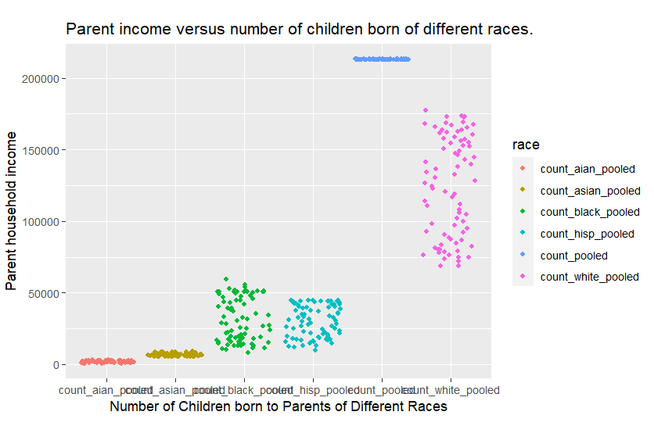
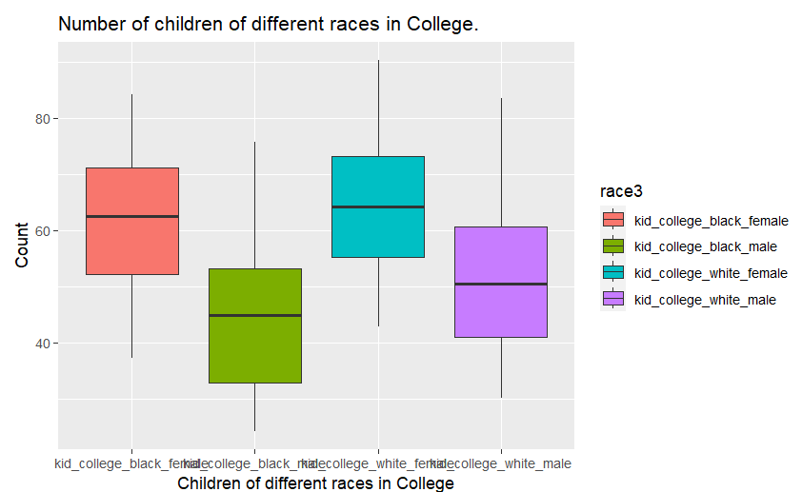
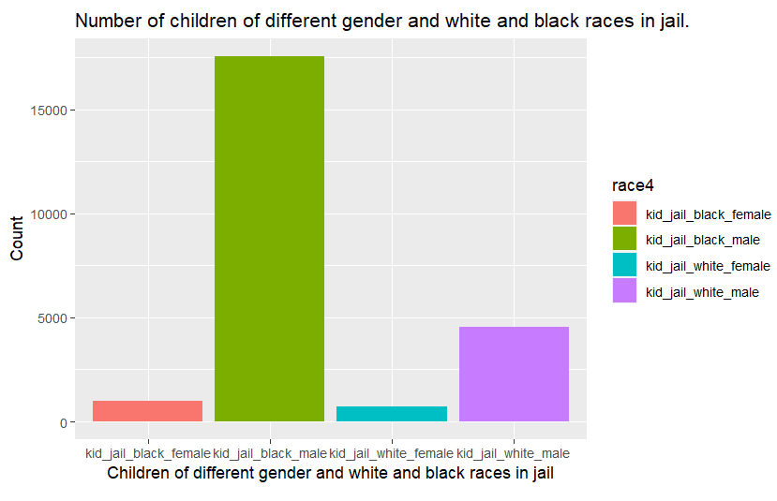
Demystifying the Complex Racial and Gender Disparities in the Economic Statuses of American Citizens
Divyalakshmi Varadha Rajan Prem Sudha ¹, Patti Hamerski ²
¹ College of Engineering, ² Computational Maths Science and Engineering
Abstract
Results
Inference and Conclusion
Racial and gender disparities in income as well as other factors of lifestyle top the list of some of the most visible and persistent issues that American society has been confronted with for decades. Even today we notice that certain sections of the societies like the American Indians and Blacks are more likely to be employed in low-wage paying occupations, have fewer children enrolled in high school or tertiary education, and have unusually high percentages of children incarcerated by race and gender.
The sources and reasons for this broadening “income gap” have been studied and debated for many years, with explanations ranging from centuries of discriminatory practices, residential segregation, and varying family structures to even genetic differences.
The drawback of most of these studies is the fact that they observe just one generation of candidates from different races. To delve further into the causes and consequences surrounding this “income gap”, I decided to explore the relationships between several factors such as household income, education, homelessness, and criminal record across five main races (Aian - American Indian and Alaska Native children, Asian, Black, Hispanic, and White) and two genders (male, female).
In Figure 1, we get to see that a majority of the data points corresponding to parents with higher household incomes (> $75,000) belong to white households.
Figure 2, a boxplot, reveals that in terms of education, children of both black and white races have almost similar counts. However, black males are in a slightly more disadvantaged situation than their white counterparts.
Figure 3, evidently portrays the portion of black male children incarcerated far exceeds the number of any other race or gender in the US.
Overall, we can notice that members of black communities have fewer access to opportunities that lead to socioeconomic mobility. Understanding and exploring these complex relationships would help facilitate a more diverse and inclusive environment for all races/genders.
Figure 1
Acknowledgments
Special Thanks to Patti Hamerski for giving me an opportunity to work on an Honors Project for the STT 180 – Introduction to Data Science class at Michigan State University. Her unwavering support has been a key contributing factor to this project.
I would also like to express my profound gratitude to Dr. Jude Higdon and the QSIDE team for giving me a platform to share my research at the Data4Justice Conference.
Methods
Figure 2
To comprehend the numerous socio-economic factors present in the dataset and analyze complex trends, the following step-wise approach was adopted:
Loading the dataset as a CSV file into R Studio
Verifying the presence of NA values and removing them, if found.
Glimpsing the table to understand the data types of the numerous factors in the dataset.
Using the pivot_longer( ) function of the dplyr package to enhance the readability of the dataset and extract important information pertaining to certain factors: children’s education, criminal record, and household income.
Using ggplot2 to observe trends across races and genders.
References
Bureau, U. S. C. (2022, October 11). Race and Economic Opportunity Data Tables. Census.gov. Retrieved April 24, 2023, from https://www.census.gov/programs-surveys/ces/data/public-use-data/race-and-economic-opportunity-data-tables.html
Figure 3

